Slide 1
HERMES TUTORIAL version 1.0
Published 24th July 2007
This tutorial version is based on the actual deployed version of Hermes, as of the date of publication. All minor updates and changes will be published in the corresponding UNEP-GEF Biosafety Unit knowledge sharing site, http://moodle.unep.ch, under the course SCBD NATIONAL BCH APPLICATION - HERMES, using the available discussions and news forums.
Major updates and changes will be collected and included in new versions or editions.

Slide 2
AGENDA
Introduction
Module 1. Accessing Hermes (15 minutes)
  About Hermes
  The National BCH website Main Page
Module 2. The Administrators’ Authentication (15 minutes)
Module 3. Content Management (30 minutes)
  Sign-Out Link
  My Profile Link
  Toggle Design Mode Icon
  File Management
Notes:
©2005 Microsoft Corporation. All rights reserved.
This presentation is for informational purposes only. Microsoft makes no warranties, express or implied, in this summary.

Slide 3
AGENDA (continued..)
Module 4. Page Management (45 minutes)
  Page Properties
  Creating New Pages
  Adding Modules to a Page
Module 5. Creating and Editing Modules
&Text (2 hours & 30 minutes)
  Content Syntax
  Reviewing/Editing Modules of a Page
  Version Management
  Deleting a Module
Notes:
©2005 Microsoft Corporation. All rights reserved.
This presentation is for informational purposes only. Microsoft makes no warranties, express or implied, in this summary.

Slide 4
AGENDA (continued..)
Module 5. (continued)
  Adding Photo Gallery Module to a Page
  Adding More Modules to a Page
  Moving Content Modules
Module 6. More on File Management (30 minutes)
  How to Customize the Banner
  The NBCH Default Stylesheet
  Modifying default.css of the NBCH Website
Notes:
©2005 Microsoft Corporation. All rights reserved.
This presentation is for informational purposes only. Microsoft makes no warranties, express or implied, in this summary.

Slide 5
Introduction
Context
  This presentation is aimed at providing a practical “how to” guide for countries to:
    assist them in learning, understanding, using and setting national access to the BCH
Audience
  This module is designed to provide guidance to administrators and users of the NBCH application using content management system called “Hermes”.
Notes:
©2005 Microsoft Corporation. All rights reserved.
This presentation is for informational purposes only. Microsoft makes no warranties, express or implied, in this summary.

Slide 6
Introduction
Purpose
  This module describes in details the guidelines and step by step process about configuring and suing HERMES to develop a National BCH website
Notes:
©2005 Microsoft Corporation. All rights reserved.
This presentation is for informational purposes only. Microsoft makes no warranties, express or implied, in this summary.

Slide 7
Questions?
Next:
Module 1. Accessing Hermes
Notes:
©2005 Microsoft Corporation. All rights reserved.
This presentation is for informational purposes only. Microsoft makes no warranties, express or implied, in this summary.

Slide 8
MODULE 1. Accessing Hermes
What you will learn from this module:
  Detailed description about Hermes
  How to access the NBCH website through browser
  Components of the NBCH website
Notes:
©2005 Microsoft Corporation. All rights reserved.
This presentation is for informational purposes only. Microsoft makes no warranties, express or implied, in this summary.

Slide 9
1.1 About Hermes
The SCBD developed an application tool called Hermes.
Hermes is an online CMS based on the Central Portal of the BCH.
A very simple and easy to use CMS that allows for the creation and edition of additional web pages, sections and contents.
Module 1. Accessing Hermes
Notes:
©2005 Microsoft Corporation. All rights reserved.
This presentation is for informational purposes only. Microsoft makes no warranties, express or implied, in this summary.

Slide 10
1.1 About Hermes (continued…)
Provides the following building blocks of a NBCH website.
  Interoperability with the Central Portal of the BCH
  Search functionalities
  Support for all common formats (national)
  Content Management (pages and text)
  File Management (images, documents, etc.)
  Menu Management
  Site Management (banner, robots.txt, etc.)
Module 1. Accessing Hermes
Notes:
©2005 Microsoft Corporation. All rights reserved.
This presentation is for informational purposes only. Microsoft makes no warranties, express or implied, in this summary.

Slide 11
1.1 About Hermes (continued…)
Provides the following building blocks of a NBCH website.
  Security (SSL authentication)
  Content Versioning (history, diff)
  Localization (will be available shortly)
Module 1. Accessing Hermes
Notes:
©2005 Microsoft Corporation. All rights reserved.
This presentation is for informational purposes only. Microsoft makes no warranties, express or implied, in this summary.

Slide 12
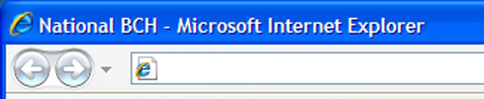
1.2 The NBCH Main Page
To access the website, type the URL using any browser (for this example we use I.E.): http://xx.biosafetyclearinghouse.net
http://la.biosafetyclearinghouse.net
As an example, we use the Lao NBCH website.
Module 1. Accessing Hermes
Notes:
©2005 Microsoft Corporation. All rights reserved.
This presentation is for informational purposes only. Microsoft makes no warranties, express or implied, in this summary.

Slide 13
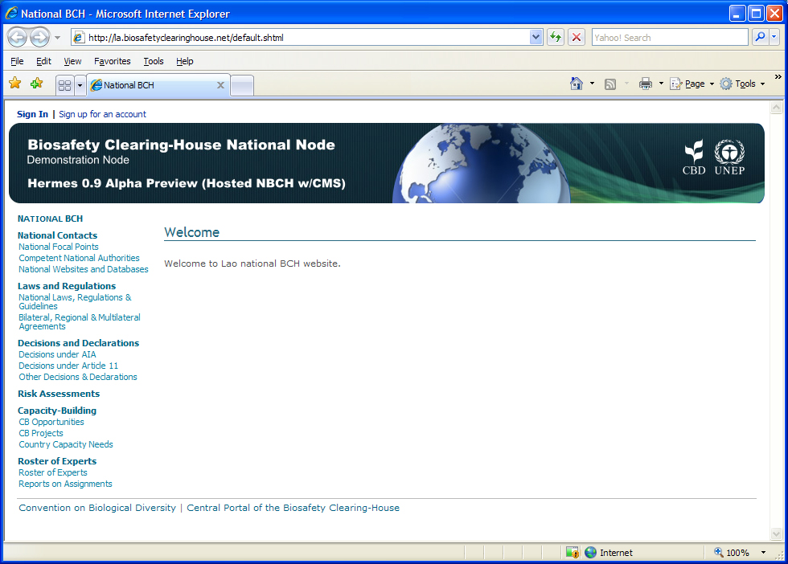
1.2 Página inicial
del sitio nCIISB
BANNER
SIGN IN/
UP LINKS
The NBCH Welcome Page and its components.
LEFT
SIDE
BAR
WEB CONTENT AREA
LINKS TO RELATED
SITES
Module 1. Accessing Hermes
Notes:
©2005 Microsoft Corporation. All rights reserved.
This presentation is for informational purposes only. Microsoft makes no warranties, express or implied, in this summary.

Slide 14
1.2 The NBCH Main Page
Components
Sign In/Up links
Sign In link will direct the users to the log-in page of the system using its appropriate log-in accounts.
Sign-up link will direct the public user to a different page to create a sign-in account for the system.
The web banner
Indicates the BCH National Node, the project implementors (SCBD, UNEP) and other brief information/icons about the country
Module 1. Accessing Hermes
Notes:
©2005 Microsoft Corporation. All rights reserved.
This presentation is for informational purposes only. Microsoft makes no warranties, express or implied, in this summary.

Slide 15
1.2 The NBCH Main Page
Components
Web content area
Introductory/brief features of the page and other relevant information
Links to related sites
Link to related websites, such as CBD and BCH Central Portal
Left Side bar
Contains Quick search tool and content titles of the website.
Module 1. Accessing Hermes
Notes:
©2005 Microsoft Corporation. All rights reserved.
This presentation is for informational purposes only. Microsoft makes no warranties, express or implied, in this summary.

Slide 16
1.2 The NBCH Main Page
Additional Note:
Hermes instance names are by default http://xx.biosafetyclearinghouse.net where xx is the ISO-3166 2-letter country code.
Countries who wish to have a different domain name can do so by registering it with the registrar of their choice and pointing it to IP 69.90.183.250 and notifying the Secretariat.
Module 1. Accessing Hermes
Notes:
©2005 Microsoft Corporation. All rights reserved.
This presentation is for informational purposes only. Microsoft makes no warranties, express or implied, in this summary.

Slide 17
Questions?
Next: Module 2. The Administrators’ Authentication
Notes:
©2005 Microsoft Corporation. All rights reserved.
This presentation is for informational purposes only. Microsoft makes no warranties, express or implied, in this summary.

Slide 18
MODULE 2. The Administrators’ Authentication
What you will learn from this module:
  To sign in and enter the Content Management of the NBCH
Notes:
©2005 Microsoft Corporation. All rights reserved.
This presentation is for informational purposes only. Microsoft makes no warranties, express or implied, in this summary.

Slide 19
2.1 Administrator Sign-in Procedure
Using the Sign-In link on the top-left of the Main Page as described in Module 1.
The NBCH administrators can sign-in using their email address and the password provided by the Secretariat.
For security considerations, authentication is made over HTTPS.
Module 2. The Administrators’ Authentication
Notes:
©2005 Microsoft Corporation. All rights reserved.
This presentation is for informational purposes only. Microsoft makes no warranties, express or implied, in this summary.

Slide 20
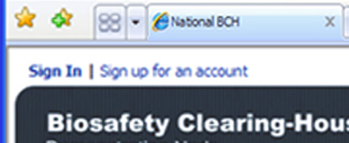
2.1 Administrator Sign-in Procedure
Steps to Sign-in: Step 1
Click on the Sign In link from the NBCH main page.
CLICK HERE
From this link, the “Sign In” page appears.
Module 2. The Administrators’ Authentication
Notes:
©2005 Microsoft Corporation. All rights reserved.
This presentation is for informational purposes only. Microsoft makes no warranties, express or implied, in this summary.

Slide 21
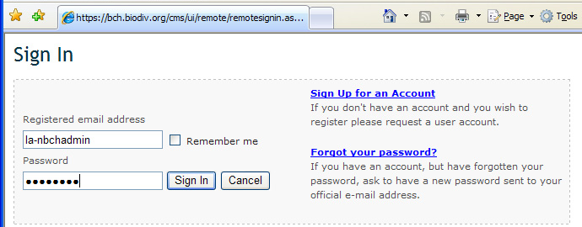
2.1 Administrator Sign-in Procedure
Other options on this page include Remember me option, account creation and password reminders.
Module 2. The Administrators’ Authentication
Notes:
©2005 Microsoft Corporation. All rights reserved.
This presentation is for informational purposes only. Microsoft makes no warranties, express or implied, in this summary.

Slide 22
2.1 Administrator Sign-in Procedure
Steps to Sign-in: Step 2
BOX 1
Inside BOX 1, type in the Administrators registered email address.
Module 2. The Administrators’ Authentication
Notes:
©2005 Microsoft Corporation. All rights reserved.
This presentation is for informational purposes only. Microsoft makes no warranties, express or implied, in this summary.

Slide 23
2.1 Administrator Sign-in Procedure
Steps to Sign-in: Step 3
BOX 2
Inside BOX 2, type in the password provided by the Secretariat. Password is case sensitive.
Module 2. The Administrators’ Authentication
Notes:
©2005 Microsoft Corporation. All rights reserved.
This presentation is for informational purposes only. Microsoft makes no warranties, express or implied, in this summary.

Slide 24
2.1 Administrator Sign-in Procedure
Steps to Sign-in: Step 3
CLICK HERE
(cont..) Then, click on the Sign In button.
Module 2. The Administrators’ Authentication
Notes:
©2005 Microsoft Corporation. All rights reserved.
This presentation is for informational purposes only. Microsoft makes no warranties, express or implied, in this summary.

Slide 25
2.1 Administrator Sign-in Procedure
NOTE:
In checking the “Remember me” box, any user will not have to provide their emails and password the next time they enter the Content Management of the NBCH Portal provided the users are signing in from the same computer.
If you use a shared computer, do not check this box. Other persons will be able to use your account.
Module 2. The Administrators’ Authentication
Notes:
©2005 Microsoft Corporation. All rights reserved.
This presentation is for informational purposes only. Microsoft makes no warranties, express or implied, in this summary.

Slide 26
Questions?
Next: Module 3. Content Management
Notes:
©2005 Microsoft Corporation. All rights reserved.
This presentation is for informational purposes only. Microsoft makes no warranties, express or implied, in this summary.

